Slide 1

Chapter 1
Introduction
1.<number>
Copyright © The McGraw-Hill Companies, Inc. Permission required for reproduction or display.
Notes:
1.#

Slide 2
1-1 DATA COMMUNICATIONS
The term telecommunication means communication at a distance. The word data refers to information presented in whatever form is agreed upon by the parties creating and using the data. Data communications are the exchange of data between two devices via some form of transmission medium such as a wire cable.
Topics discussed in this section:
Components
Data Representation
Data Flow
1.<number>
Notes:
1.#

Slide 3

Figure 1.1 Five components of data communication
1.<number>
Notes:
1.#

Slide 4

Figure 1.2 Data flow (simplex, half-duplex, and full-duplex)
1.<number>
Notes:
1.#

Slide 5
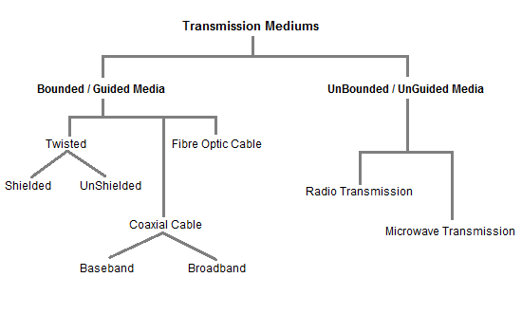
1.<number>

Slide 6
1-2 NETWORKS
A network is a set of devices (often referred to as nodes) connected by communication links. A node can be a computer, printer, or any other device capable of sending and/or receiving data generated by other nodes on the network.
Topics discussed in this section:
Distributed Processing
Network Criteria
Physical Structures
Network Models
Categories of Networks
Interconnection of Networks: Internetwork
1.<number>
Notes:
1.#

Slide 7

Figure 1.3 Types of connections: point-to-point and multipoint
1.<number>
Notes:
1.#

Slide 8

Figure 1.4 Categories of topology
1.<number>
Notes:
1.#

Slide 9

Figure 1.5 A fully connected mesh topology (five devices)
1.<number>
Notes:
1.#

Slide 10
MESH TOPOLOGY
It has link between each device in the network.It is more difficult to install as the no.of devices increases
Easy to troubleshoot
Much of the bandwidth available in mesh configuration is wasted
ADVANTAGES:
1.Trouble shooting is easy
2.Isolation of network failures is easy
DISADVANTAGES:
1.Difficulty of installation
2.Costly because of maintain redundant links
3.Difficulty of reconfiguration
1.<number>

Slide 11

Figure 1.6 A star topology connecting four stations
1.<number>
Notes:
1.#

Slide 12
STAR TOPOLOGY
Star topology consists of number of devices connected by point to point links to a central hub.
Easy to control and traffic flow is simple
Data travels from the sender to central hub and then to the receiver
ADVANTAGES
1.Easy to modify and add new nodes to a star network without disturbing the rest of the network
2.Troubleshooting techniques are easy
3.Failures of any node do not bring down the whole star network
DISADVANTAGES:
1.If the central hub fails,the whole network fails to operate
2.Each device requires its own cable segment
3.Installation can be moderately difficult, especially in the hierarchical network
1.<number>

Slide 13

Figure 1.7 A bus topology connecting three stations
1.<number>
Notes:
1.#

Slide 14
BUS TOPOLOGY
1.Also called horizontal topology
2. Multiple devices are connected one by one,by means of connectors or drop cables
3. When one computer sends a signal up the wire,all the computers on the network receive the information, but only one accepts the information(using address matching).The rest discard the message.
ADVANTAGES:
1.Easy to use and easy to install
2.Needs fewer physical connectivity devices
3.A repeater can also be used to extend a bus topology network
4.Low cost
DISADVANTAGES:
1.Heavy network traffic can slow a bus considerably
2.It is difficult to trouble shoot a bus
3. Failure of cable affects all devices on the network.
4.Diffcult to add new node.
1.<number>

Slide 15

Figure 1.8 A ring topology connecting six stations
1.<number>
Notes:
1.#

Slide 16
RING TOPOLOGY
Each computer is connected to the next computer,with the last one connected to the first.
Signal travel on the cable in only one direction
Each computer retransmits what it receives
Active network.Termination is not required
ADVANTAGES:
Cable failures are easily found
Because every node is given equal access to the token,no one node can monopolize the network.
DISADVANTAGES:
Adding or removing nodes disrupts the network
It is difficult to troubleshoot a ring network
Failure of one node on the ring can affect the whole network
Cost of cable is more in ring network
1.<number>

Slide 17
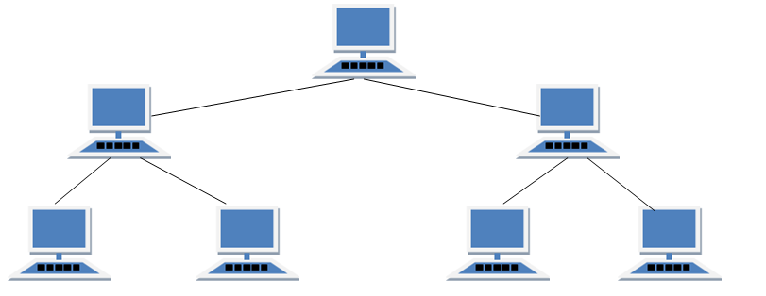
Tree Topology
1.<number>

Slide 18
TREE Topology
It has a root node and all other nodes are connected to it forming a hierarchy.
It is also called hierarchical topology.
It should at least have three levels to the hierarchy.
Features of Tree Topology
Ideal if workstations are located in groups.
Used in Wide Area Network.
Advantages of Tree Topology
Extension of bus and star topologies.
Expansion of nodes is possible and easy.
Easily managed and maintained.
Error detection is easily done.
Disadvantages of Tree Topology
Heavily cabled.
Costly.
If more nodes are added maintenance is difficult.
Central hub fails, network fails.
1.<number>

Slide 19

Figure 1.9 A hybrid topology: a star backbone with three bus networks
1.<number>
Notes:
1.#

Slide 20
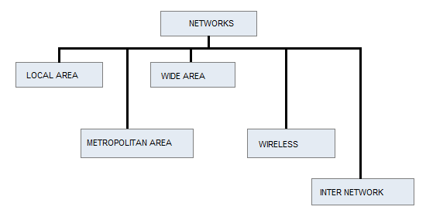
Network Types
1.<number>

Slide 21

Figure 1.10 An isolated LAN connecting 12 computers to a hub in a closet
1.<number>
Notes:
1.#

Slide 22
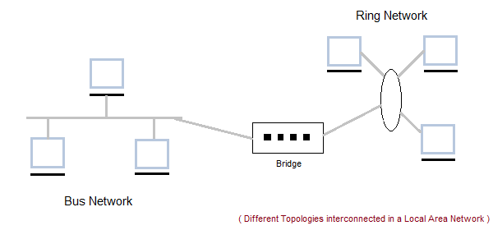
LAN
Designed for small physical areas such as an office, group of buildings or a factory.
We can use different types of topologies through LAN, these are Star, Ring, Bus etc.
LAN networks are also widely used to share resources like printers, shared hard-drive etc.
LAN operates on the principal of broadcasting
1.<number>

Slide 23
Contd…
One of the computer in a network can become a server serving all the remaining computers called clients.
Software can be stored on the server and it can be used by the remaining clients.
Connecting Locally all the workstations in a building to let them communicate with each other locally
without any internet access.
LAN STANDARDS: IEEE 802 →IEEE 802.3,802.4,802.5
Provides users
Flexibility
Speed
Reliability
Adaptability
Centralized management
Transparent interface
1.<number>

Slide 24
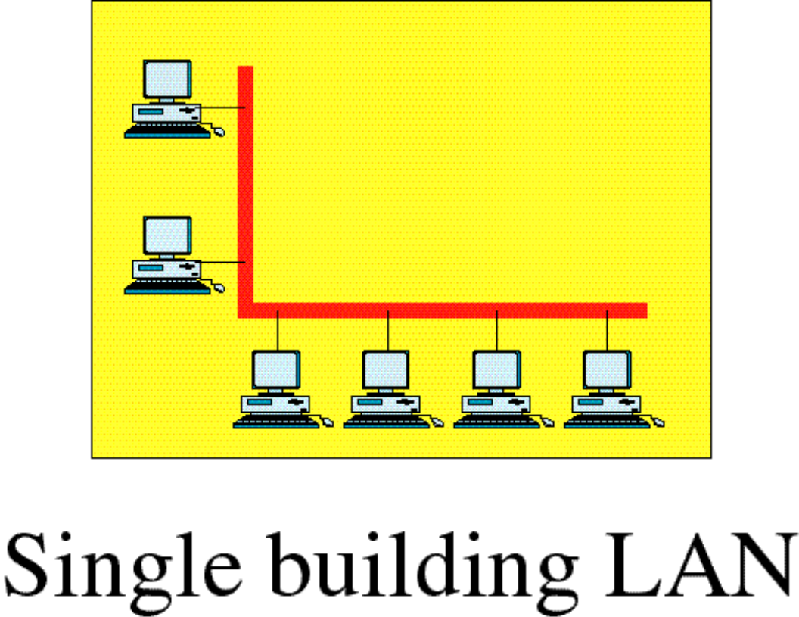
LAN
1.<number>

Slide 25
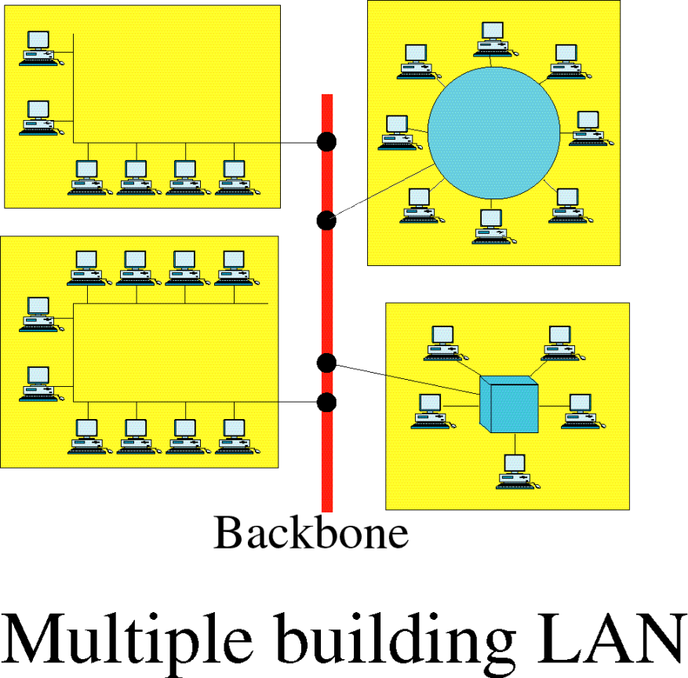
Contd…
1.<number>

Slide 26
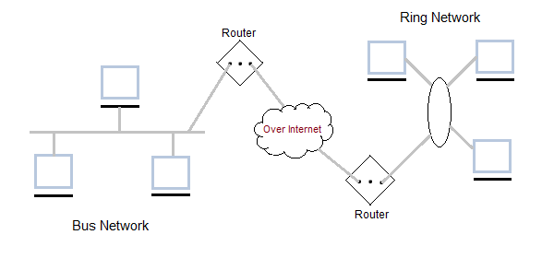
WAN
A LAN is normally limited in size, spanning an office, a building, or a campus;
but WAN has a wider geographical span, spanning a town, a state, a country or even the world.
LAN privately owned by the organization that uses it. WAN is normally created and run by communication companies and leased by an organization that uses it.
Communication medium used by WAN are PSTN or Satellite links.
PSTN-world’s collection of interconnected voice-oriented public telephone network
WAN operates on low data rates.
1.<number>

Slide 27
WAN
Point –to-point WAN
Switched WAN
Point –to-point WAN:
Connects communicating devices through a transmission media(cable or air)
Switched WAN:
It is a network with more than two ends.
It is a combination of several point-to-point WAN –connected by switches.
1.<number>

Slide 28

Figure 1.11 WANs: a switched WAN and a point-to-point WAN
1.<number>
Notes:
1.#

Slide 29
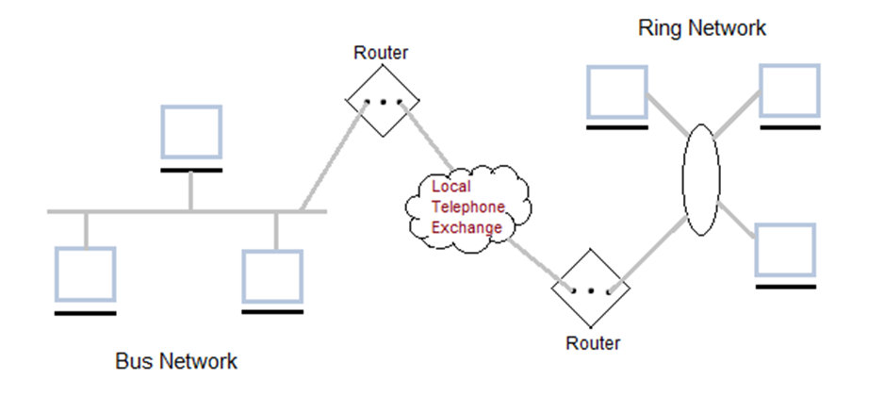
MAN
Metropolitan Area Network (MAN)
It is basically a bigger version of LAN.
It is also called MAN and uses the similar technology as LAN.
It is designed to extend over the entire city. It can be means to connecting a number of LANs into a larger network or it can be a single cable.
It is mainly hold and operated by single private company or a public company.
1.<number>

Slide 30

Figure 1.12 A heterogeneous network made of four WANs and two LANs
1.<number>
Notes:
1.#

Slide 31
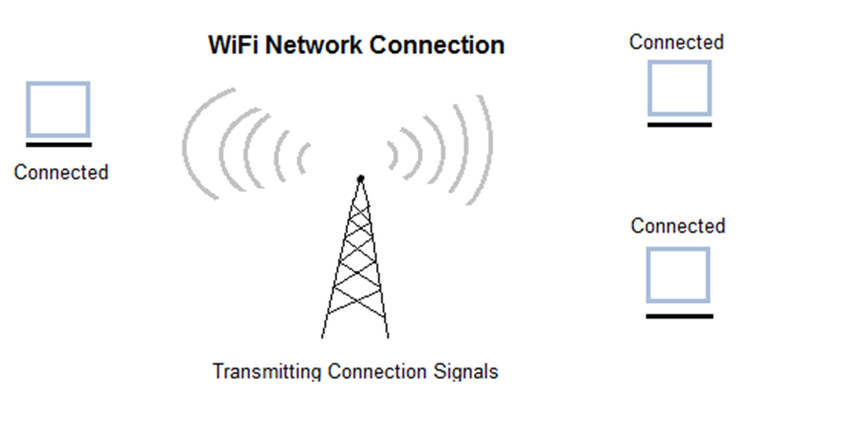
Wireless Network
It is the fastest growing segment of computer.
They are becoming very important in our daily life because wind connections are not possible in cars or aeroplane.
We can access Internet at any place avoiding wire related troubles.
These can be used also when the telephone systems gets destroyed due to some calamity/disaster.
1.<number>

Slide 32
Wireless Networks
A wireless LAN or WLAN is a wireless local area network that uses radio waves as its carrier.
It operate in almost the same way as wired LANs, using the same networking protocols and supporting the most of the same applications
They integrate into existing networks through access points which provide a bridging function.
Wireless Access Points (Aps) is a small device that bridges wireless traffic to your network.Most access point’s bridge wireless LAN s into Ethernet networks,but Token-Ting options are available as well.
WLAN version: IEEE 802.11: IEEE 802.11a , 802.11b, 802.11g,802.11e,802.11f,802.11i
WiMAX is the acronym meaning of “Worldwide Interoperability for Microwave Access”
Technologies:
1.Frequency Hopping Spread Specturm (FHSS)
2.Direct Sequence Spread Specturm(DSSS)
3.Infrared (IR)
4.Orthogonal Frequency Division Multiplexing(OFDM)
1.<number>

Slide 33
1-3 THE INTERNET
The Internet has revolutionized many aspects of our daily lives. It has affected the way we do business as well as the way we spend our leisure time. The Internet is a communication system that has brought a wealth of information to our fingertips and organized it for our use.
Topics discussed in this section:
A Brief History
The Internet Today (ISPs)
1.<number>
Notes:
1.#

Slide 34
Internet
Internet backbone : A set of high-speed networks that carry Internet traffic
These networks are provided by companies such as AT&T, GTE, and IBM
Internet service provider (ISP) : A company that provides other companies or individuals with access to the Internet
There are various technologies available that you can use to connect a home computer to the Internet
  A phone modem converts computer data into an analog audio signal for transfer over a telephone line, and then a modem at the destination converts it back again into data
  A digital subscriber line (DSL) A digital subscriber line (DSL) modem is a device used to connect a computer or router to a telephone line which provides the digital subscriber line service for connectivity to the Internet, which is often called DSL broadband.
  A cable modem uses the same line that your cable TV signals come in on to transfer the data back and forth
Broadband A connection in which transfer speeds are faster than 128 bits per second
  DSL connections and cable modems are broadband connections
  The speed for downloads (getting data from the Internet to your home computer) may not be the same as uploads (sending data from your home computer to the Internet)
1.<number>

Slide 35

Figure 1.13 Hierarchical organization of the Internet
1.<number>
Notes:
1.#

Slide 36
1-4 PROTOCOLS AND STANDARDS
In this section, we define two widely used terms: protocols and standards. First, we define protocol, which is synonymous with rule. Then we discuss standards, which are agreed-upon rules.
Topics discussed in this section:
Protocols
Standards
Standards Organizations
Internet Standards
1.<number>
Notes:
1.#

Slide 37
1.<number>

Slide 38
802.11 only supported a maximum network bandwidth of 2 Mbps - too slow for most applications. For this reason, ordinary 802.11 wireless products are no longer
Pros of 802.11b - lowest cost; signal range is good and not easily obstructed
Cons of 802.11b - slowest maximum speed; home appliances may interfere on the unregulated frequency band
802.11a supports bandwidth up to 54 Mbps and signals in a regulated frequency spectrum around 5 GHz. This higher frequency compared to 802.11b shortens the range of 802.11a networks. The higher frequency also means 802.11a signals have more difficulty penetrating walls and other obstructions.
Pros of 802.11a - fast maximum speed; regulated frequencies prevent signal interference from other devices
Cons of 802.11a - highest cost; shorter range signal that is more easily obstructed
Wi-Fi stands for Wireless Fidelity. Wi-Fi is based on the IEEE 802.11 family of standards and is primarily a local area networking (LAN) technology designed to provide in-building broadband coverage.
Current Wi-Fi systems based on IEEE 802.11a/g support a peak physical-layer data rate of 54Mbps and typically provide indoor coverage over a distance of 100 feet.
Wi-Fi has become the defacto standard for last feet broadband connectivity in homes, offices, and public hotspot locations. systems can typically provide a coverage range of only about 1,000 feet from the access point.
Wi-Fi offers remarkably higher peak data rates than do 3G systems, primarily since it operates over a larger 20MHz bandwidth, but Wi-Fi systems are not designed to support high-speed mobility.
One significant advantage of Wi-Fi over WiMAX and 3G is the wide availability of terminal devices. A vast majority of laptops shipped today have a built-in Wi-Fi interface. Wi-Fi interfaces are now also being built into a variety of devices, including personal data assistants (PDAs), cordless phones, cellular phones, cameras, and media players.
1.<number>

